Slide 1

Should There Be Limitations for Social Media?
Presented by :
Burhanuddin Bohra
Chirag Sharma
Vanshika Gawate
Tanya Mahajan
Yuvraj Nakwal

Slide 2

Introduction to Social Media
Social media platforms are digital spaces where users can create, share, and interact with content and other individuals. These platforms have profoundly reshaped communication, news consumption, and entertainment in our daily lives.
Prominent examples include Facebook, Instagram, Twitter (now X), TikTok, and YouTube, each offering unique ways to connect and engage.

Slide 3




The Profound Importance of Social Media
Global Connectivity
Social media eradicates geographical barriers, enabling instant communication and the rapid exchange of information across continents.
Empowering Voices
It empowers individuals and organisations to articulate ideas, champion causes, and cultivate vibrant online communities.
Catalyst for Change
Beyond social interaction, these platforms actively support educational initiatives, business growth, and significant social movements.

Slide 4




Pressing Concerns Regarding Social Media
Information Distortion
The rapid dissemination of misinformation, 'fake news,' and conspiracy theories poses a significant societal challenge.
Online Harassment
Social media can become a breeding ground for cyberbullying, trolling, and the proliferation of hate speech, impacting user well-being.
Privacy and Data Risks
Extensive data collection practices and potential security vulnerabilities raise serious privacy concerns for users worldwide.

Slide 5

Arguments Supporting Limitations
Mental Well-being
Privacy Safeguards
Targeted limitations can reduce addictive behaviours and negative mental health impacts, particularly among younger users, promoting healthier digital habits.
Content Control
Regulations help to protect user privacy and mitigate the risks associated with the misuse of personal data by platforms.
Limitations can effectively curb the spread of harmful content, such as hate speech and dangerous misinformation, fostering a safer online environment.

Slide 6

Arguments Against Limitations
Critics argue that imposing limitations on social media could directly infringe upon fundamental principles of freedom of speech and expression, essential rights in democratic societies.
There is a significant risk of censorship and the potential for regulatory power to be abused, leading to biased content moderation or suppression of dissenting voices.
Overly strict regulations might stifle innovation within the tech sector and limit public access to a diverse range of information and perspectives.

Slide 7
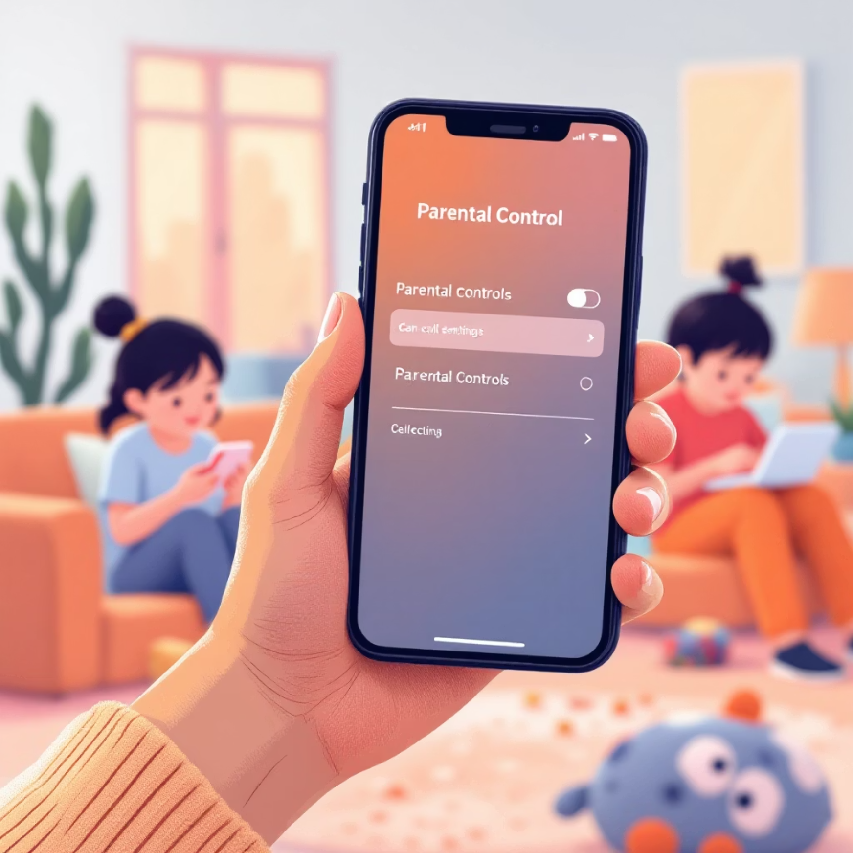
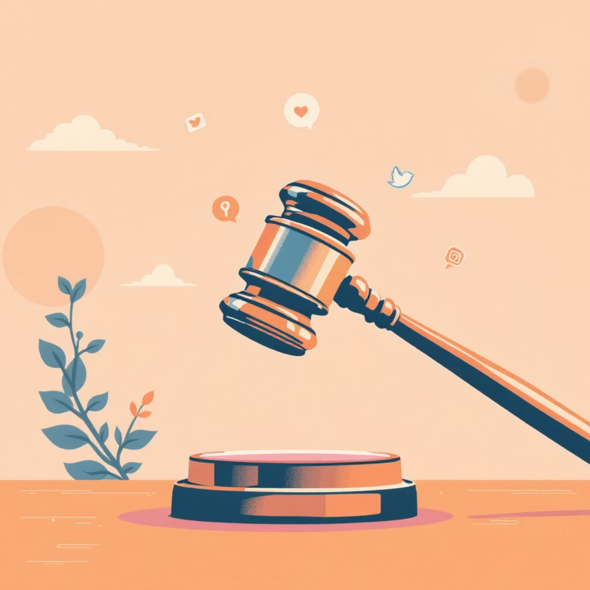
Existing Regulations and Policies
Numerous nations have enacted legislation to govern social media, with a particular focus on safeguarding minors.
Examples include mandates for age verification, requirements for parental consent, and restrictions on the collection of data from underage users.
In India, new regulations encompass robust content moderation frameworks and accessible grievance redressal mechanisms for users.

Slide 8

Potential Types of Limitations
Content Moderation
1
Implementation of advanced systems and human oversight for content moderation and fact-checking to identify and address harmful material.
Age & Parental Controls
2
Strict age restrictions for platform access and enhanced parental control features to ensure a safer environment for younger users.
Data Protection Laws
3
Enforcement of stringent data protection laws and limits on how platforms can use algorithmic targeting for advertising or content delivery.

Slide 9

The Crucial Role of Social Media Companies
Platforms must embrace their responsibility for proactive self-regulation and uphold unwavering transparency in their operations.
They should develop and implement user-friendly tools that enable individuals to easily report harmful content and manage their privacy settings effectively.
Collaborative efforts with governmental bodies are essential to strike a delicate balance between ensuring user safety and preserving fundamental freedoms on digital platforms.

Slide 10
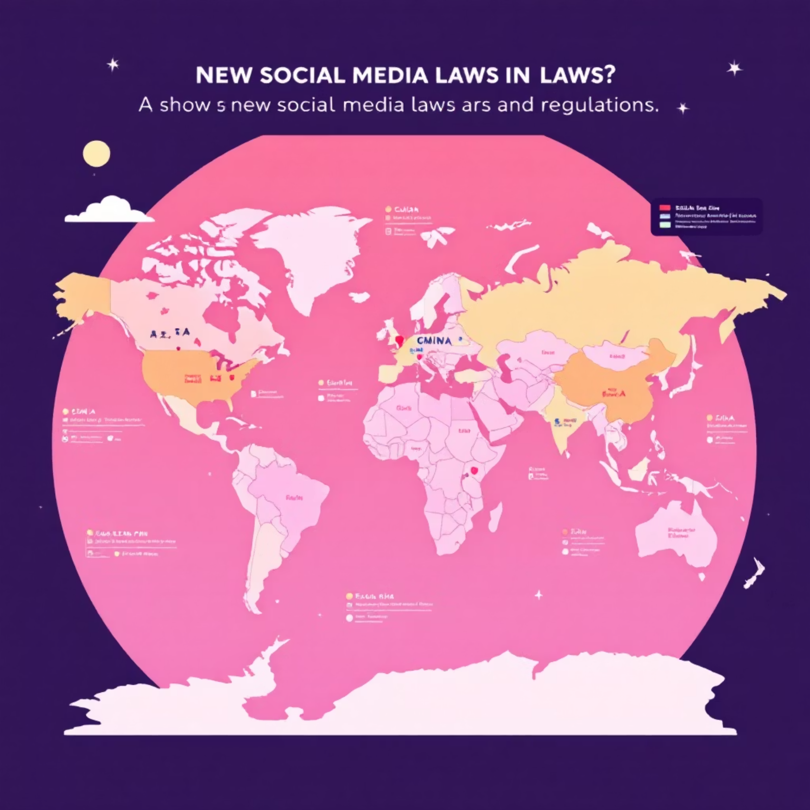
Recent Developments & Global Trends
As of 2025, a growing number of states and countries have enacted new legislation specifically targeting social media, with a strong emphasis on age verification, parental consent, and robust data protection measures.
An ongoing and vigorous debate surrounds the efficacy and fairness of these regulations, particularly concerning the rights of minors and the cultivation of digital literacy.
Some experts advocate for a shift in focus towards enhancing digital literacy and emotional regulation skills, rather than implementing outright bans or overly restrictive policies.

Slide 11

Conclusion
Limitations on social media are essential to guide responsible use, not to suppress creativity. Balancing freedom with accountability creates a healthier, more meaningful social media environment for everyone.

